Slide 1
Introduction
Session 1
ICT Entrepreneurship
Prof. Sjaak Brinkkemper
Dr. Gerard Wagenaar
Notes:
1

Slide 2
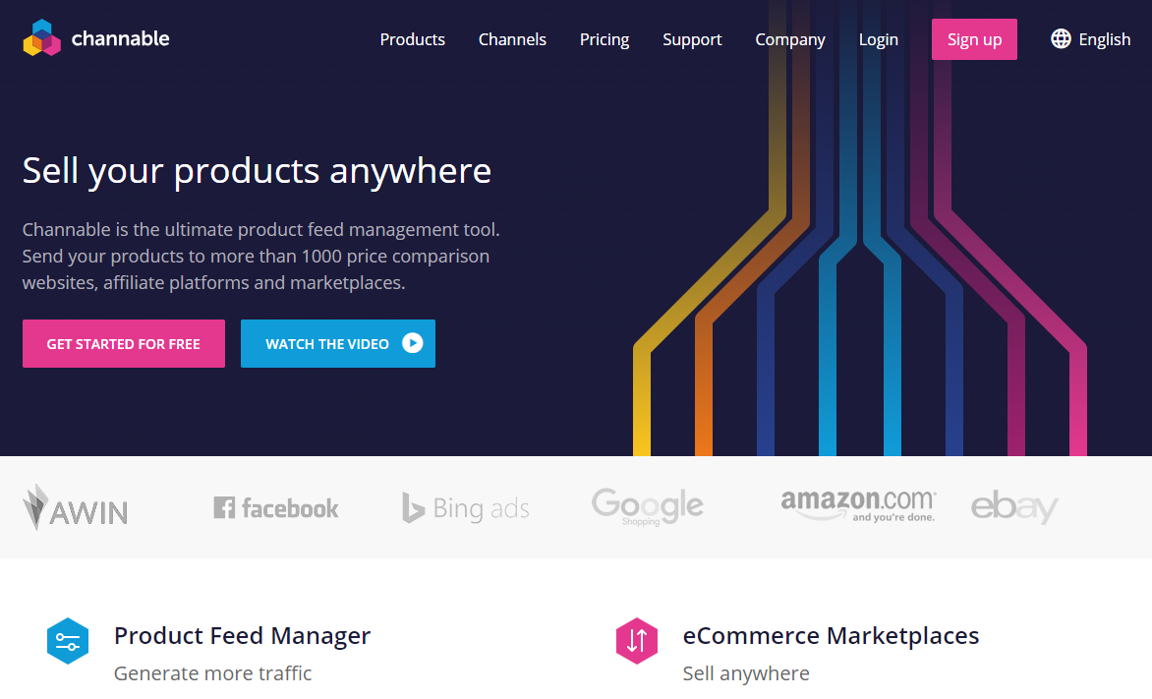
Channable
Est. 2014
By three former UU students Rob van Nuenen MBI, Stephan Hospes GMT, Robert Kreuzer COSC.
Pivot from Site2Mobile
Now:
Revenue of approx 5 mln
140 people
HQ Utrecht

Slide 3
And also …
Dirict (sold)
Yunoo (sold)
Channable
YourTicketProvider
Relay42
Tournify
Konjoin
YourNextConcepts
App4Mation
Oddity
Revue (sold)
…
Or in key roles at:
Uber
TripAdvisor
Box

Slide 4
Traits of the innovative entrepreneur
Active desire to change the status quo
Willing to take risks to make such change happen.
Combine persistence in strategy with flexibility in tactics
Treats failure with respect and uses it as an opportunity to learn and try something new:
mistakes are nothing to be ashamed of
they are expected as a cost of doing business
if no mistakes, not trying hard enough
Adapted from Dyer, Gregersen, & Christensen, “The Innovator’s DNA,” Harvard Business Review, 2009

Slide 5

“On A Mission for Change”
“Embracing a mission for change makes it much easier to take risks and make mistakes”
Innovators rely on their “courage to innovate”
active bias against the status quo
determined willingness to take risks
…to “transform ideas into powerful impact.”

Slide 6
Day 1 - Agenda
13:15 - 14:00: Course introduction - Contents
14:00 - 14:15: Break
14:15 - 14:30: Course introduction - Structure
14:30 - 15:30: Present you(r idea)
15:30 - 15:45: Break
15:45 - 17:00: Team formation

Slide 7
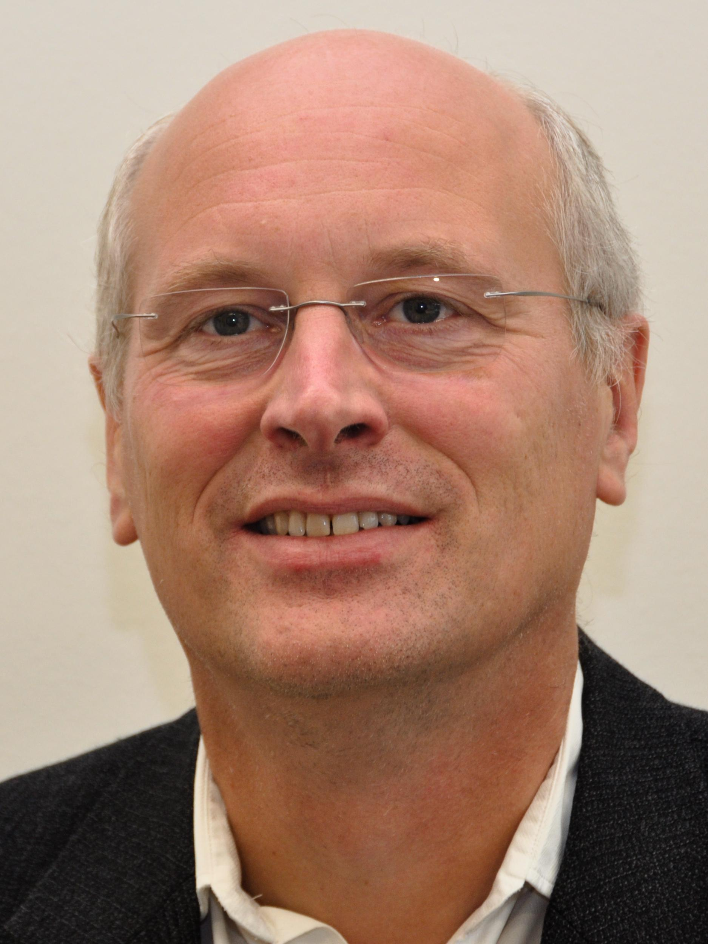
Sjaak Brinkkemper
Research
Methods for requirements and architecture
Software Production
ICT Entrepreneurship
Projects
Care2Report: Automated Medical Reporting

Slide 8
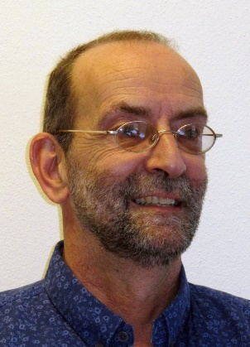
Gerard Wagenaar
Informatica, Universiteit van Amsterdam, 1986
Proefschrift “Artefacts in Agile Team Communication”, Universiteit Utrecht, 2019
Werkervaring: Toegepast onderzoek (TNO), Projectbegeleider (EU), Management (Grafische industrie), ZZP, Onderwijs (Avans Hogeschool / UU)
Bij UU:
Onderzoeksinteresse: Agile Software Development
Vakken: ICT Entrepeneurship, Organisaties & ICT, Product Software
Organisatie: Coördinator MBI

Slide 9
Course Learning Objectives
After this course the student should:
know what developing a software product entails
be able to work with the scientific theories of product software
understand how to turn academic results into successful businesses
be able to validate potential business ideas, i.e., use lean innovation and be able to pivot
be able to define success metrics and adjust business plans accordingly
concisely present a business plan or idea, in the form of pitch presentations
be able to rapidly develop a minimum viable product

Slide 10
Lecturers
Gerard Wagenaar
Sjaak Brinkkemper
All course related emails:
Prefix subject with [ICT-E]
To: Gerard and Sjaak
Student assistant
None (yet)

Slide 11
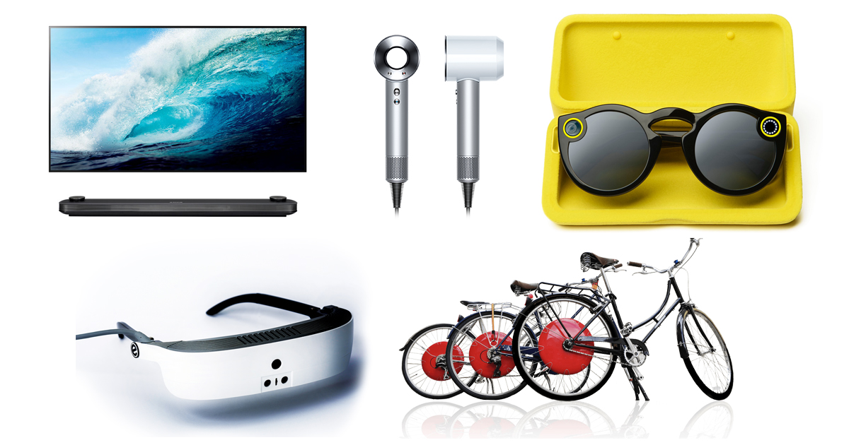
Societal context
ICT innovations create new products, services, companies, jobs, economic value, social value
International: Uber
Twitter
Google SAP Microsoft Sage
Software AG …
Netherlands: Adyen
Keylane
Booking
TomTom Planon Centric Exact Unit4 …
Time Magazine, 2017

Slide 12
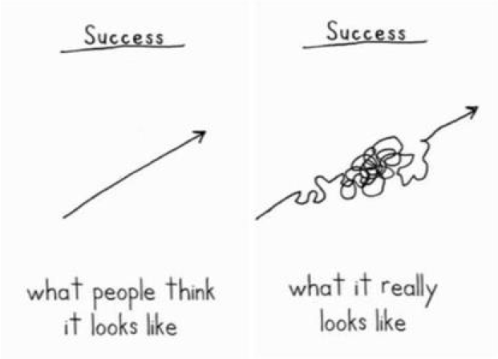
Demetri Martin, author This Is A Book

Slide 13
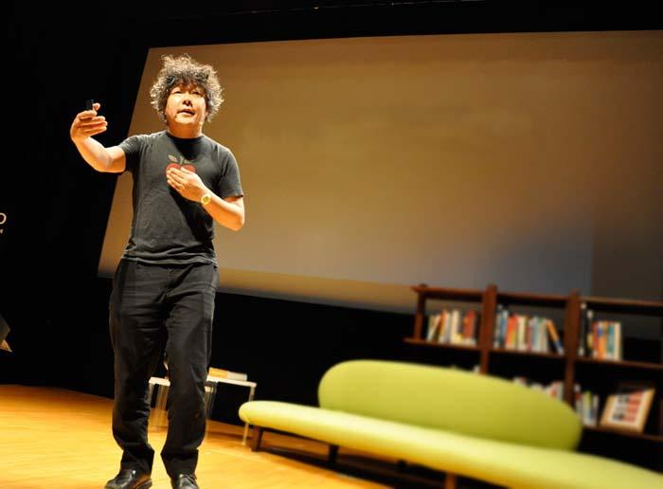
success
The greatest form of is
to create new things so that
can achieve
success at the same time.
you and others
Kenichiro Mogi
brain scientist
Notes:
13

Slide 14



Affordable Care
Eliminate the keyboard in healthcare
Automated Medical Reporting with speech and action recognition, AI, and natural language processing.
www.care2report.nl

Slide 15
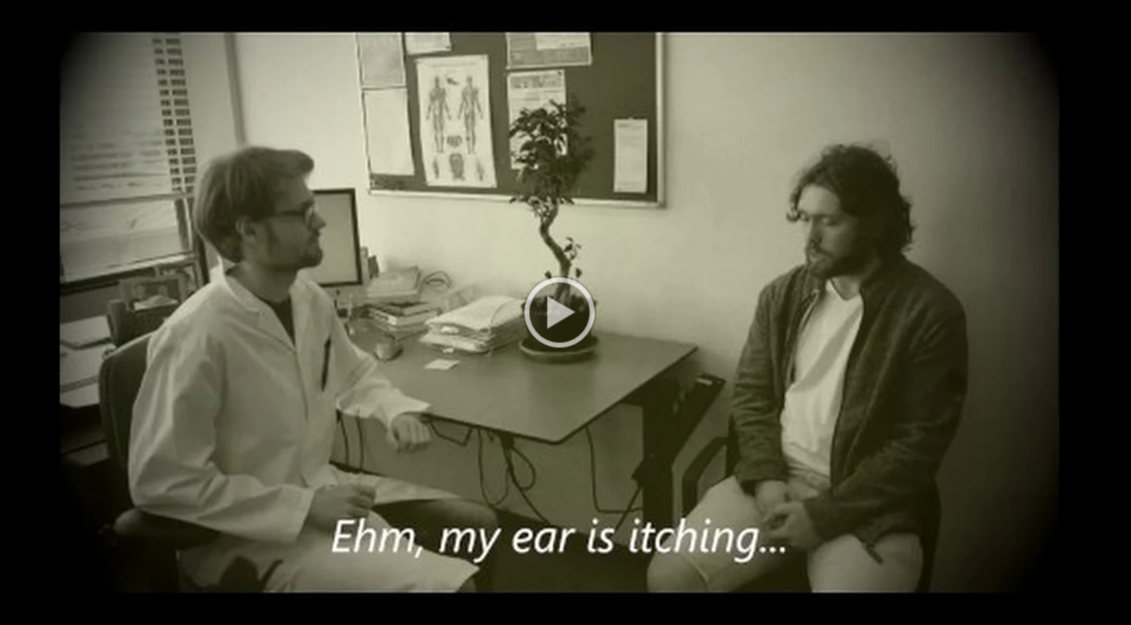
The current proof-of-concept
Demo video prototype (July 2019)

Slide 16
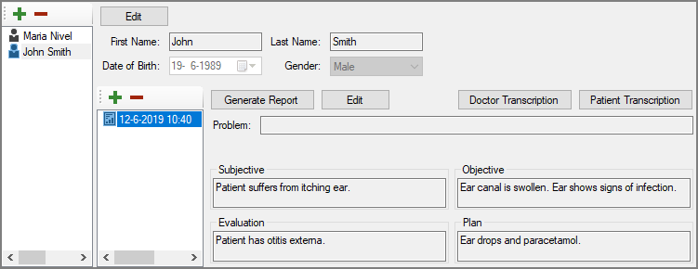
The first automatically generated report!
Generated report based on a transcript from a GP consultation concerning otitis externa. Note: generated without manual intervention.

Slide 17
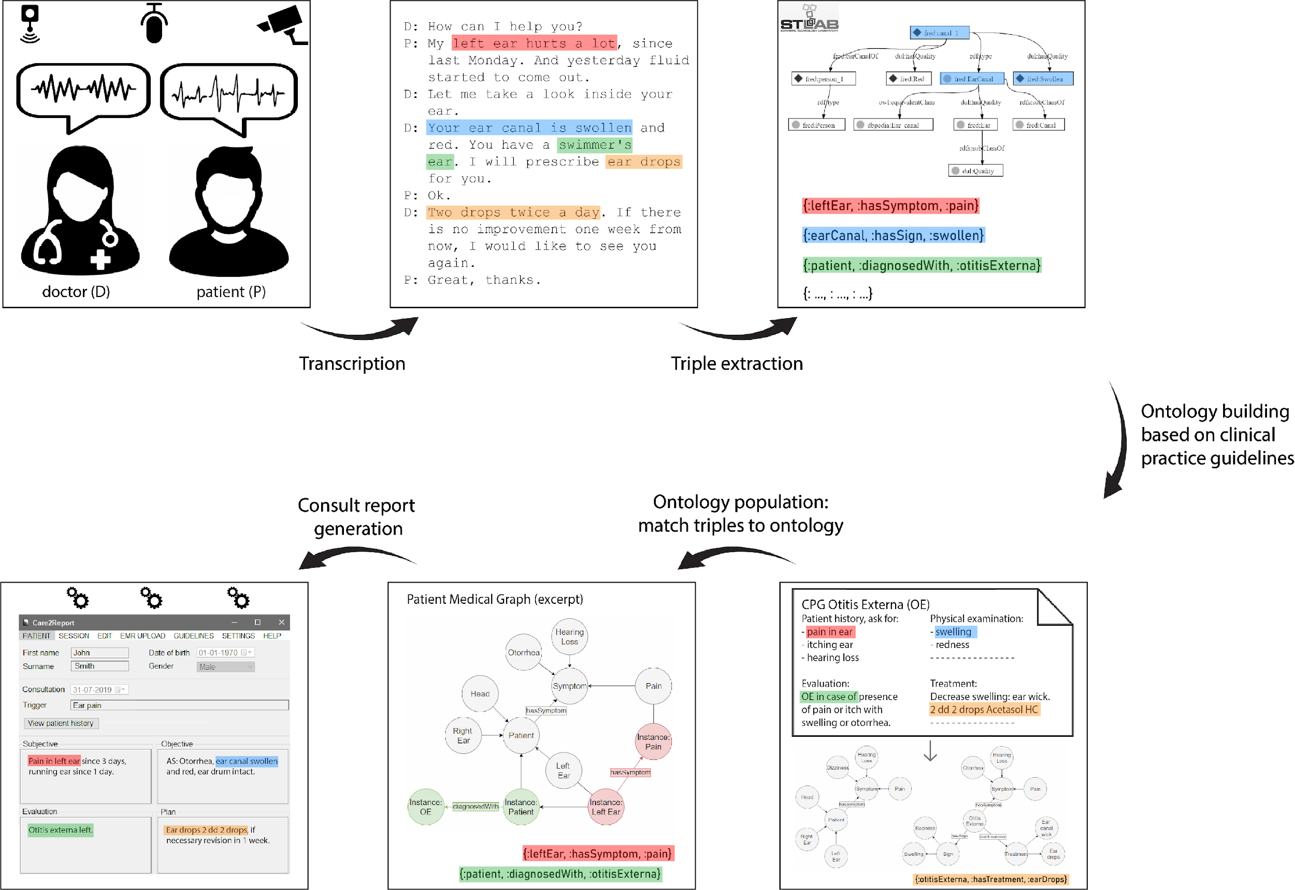

Slide 18
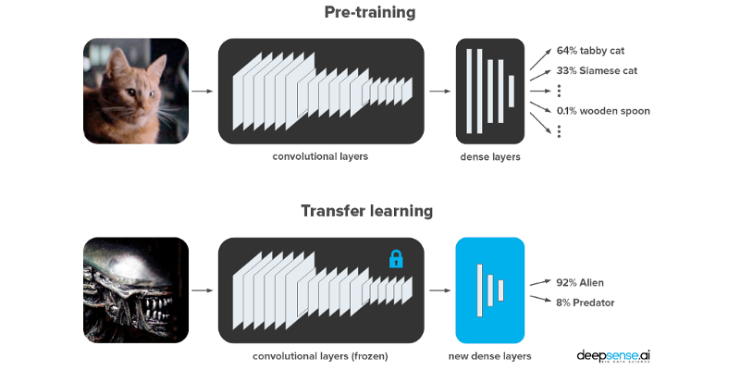
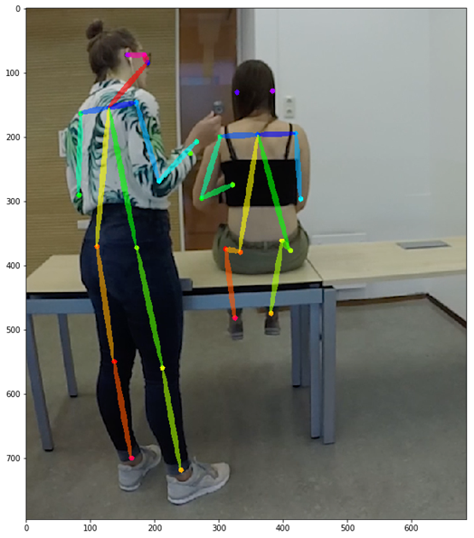
Action recognition and summarization
Convolutional neural network
72% heart-lung auscultation
28% lung auscultation

Slide 19
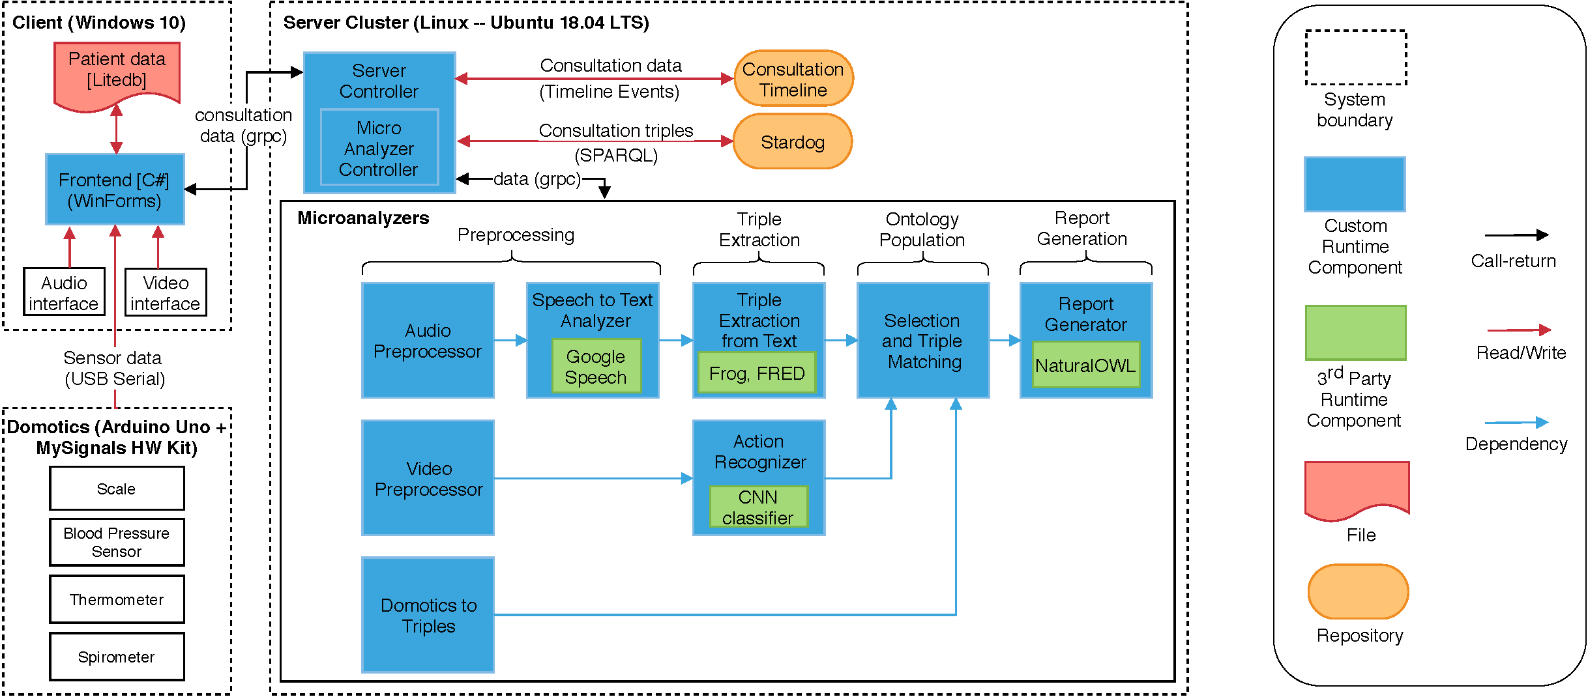
C2R - Technical Architecture

Slide 20
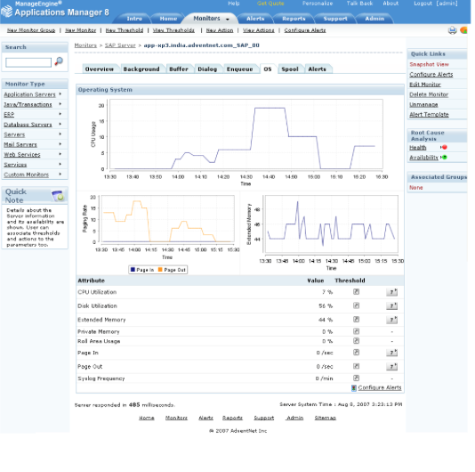
What is Product Software?
A Software Product is defined as
a packaged configuration of software components, or a software-based service with auxiliary materials, which is released for and traded in a specific market
Examples:
ERP software
Book keeping service
Operating systems
Desktop publishing
Computer-aided design
Software development environments
Customer-relationship management
…
Essentially all software you are using in daily life and work …
See Xu and Brinkkemper, 2007.

Slide 21
What is Product Software?
Examples of Software Product companies are:
International: Microsoft, Oracle, SAP, Google, …
NL: TomTom, Exact, GX, Unit4, Planon, …
Differentiate from:
Tailor-made (or bespoke) software (large ICT service companies such as Capgemini, ATOS-Origin, CGI, …)
Embedded software (consumer electronics, wearables, office machinery: Philips, Oce, AMSL, …)
In the course ICT-Entrepreneurship the creation, production and organization of product software will be discussed and elaborated in depth

Slide 22
Key differences
Market introduction requires precise synchronization of dependable software engineering activities
The same product requires installation and usage in different organizations, with different hardware and software platforms
The vendor company stays owner of the software and auxiliary materials, while the usage is licensed to the customers
Notes:
See paper: Concept of Product Software EJIS journal, Sjaak

Slide 23
Types of software products
System infrastructure software
Development tools
Enterprise applications (Business to business, B2B)
Consumer apps and games (Business to consumer, B2C)
Software intensive business
See: Xu and Brinkkemper (2007). Note: the last category was not identified yet.
Notes:
23

Slide 24
Product types
System infrastructure software
Foundation of software stack
Security, systems management
Not industry or function specific
Many in open source
Segments
Operating systems
Network, storage, security
Utilities, anti-virus, archiving
Tools
Development, execution
Allow for composition, reuse, optimization
Segments
Portal and collaboration: user interface infrastructure
Information management: data layer
Modeling and development: for application logic
Execution and Integration platforms: execution of appl. logic
Notes:
24

Slide 25
Product types (2)
Enterprise applications
Used by information workers and end-users
Bring some level of automation in business processes
Most are industry or function specific
Few in open source
Segments
Office automation
Horizontal business apps: finance&accounting, HRM, CRM, ERP
Vertical business apps for industry specific solutions: billing, banking, travel reservations
Technical applications: design and creation of physical products
Games and Consumer apps
Consumer and professional games
Strongest shift from packaged to online
Segments
Offline: Home consoles, handheld consoles, computers
Online: PC and mobile phones
Consumer apps: editing of video and photo, hobbies

Slide 26
Product types (3)
Software intensive business
Large platforms for service provisioning
Centralized ecosystem
Basic role expands in value chain: reservation to marketing and payments; distribution to production
Segments
Travel: Booking, TripAdvisor
Digital distribution: Netflix, Spotify
FinTech: Knab
Food: TakeAway, Deliveroo

Slide 27
Discussion
System infrastructure software
Development tools
Enterprise applications (Business to business, B2B)
Consumer apps and games (Business to consumer, B2C)
Software intensive business
Discussion:
In what type of product falls your idea?
Where did Booking start? Find on the web.
Where did Gitlab start?
What types are best suited for a software startup?
Are there geographic differences in startup opportunities?
Notes:
27

Slide 28

Economic context
OECD “The product software sector is among the most rapidly growing sectors in OECD countries, with strong increases in value added, employment and R&D investment.”
EU
2.7 M employees
NL
Import 1,2 B€, Export 1,6 B€
NL: 60.000 employees in NL companies
17.5 % of 345.000 total ICT employment

Slide 29
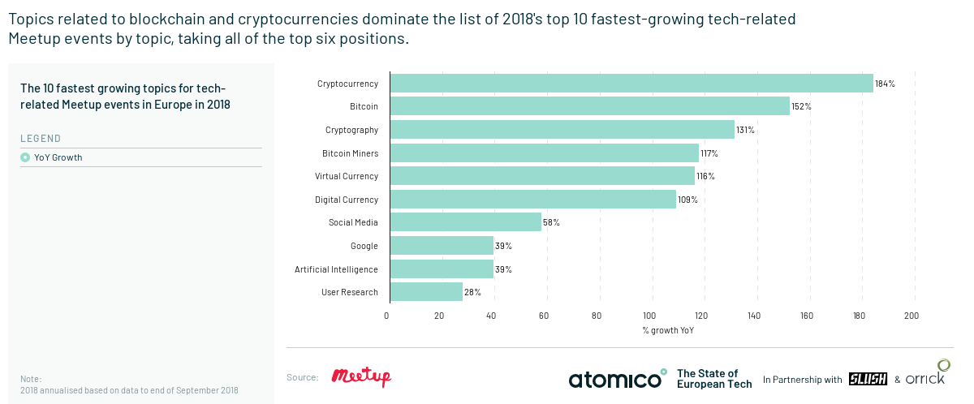
Hot topics

Slide 30
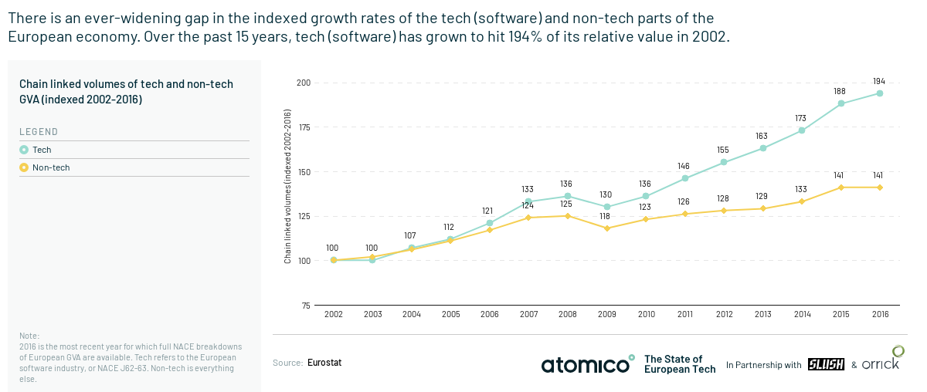
Tech growth rate

Slide 31
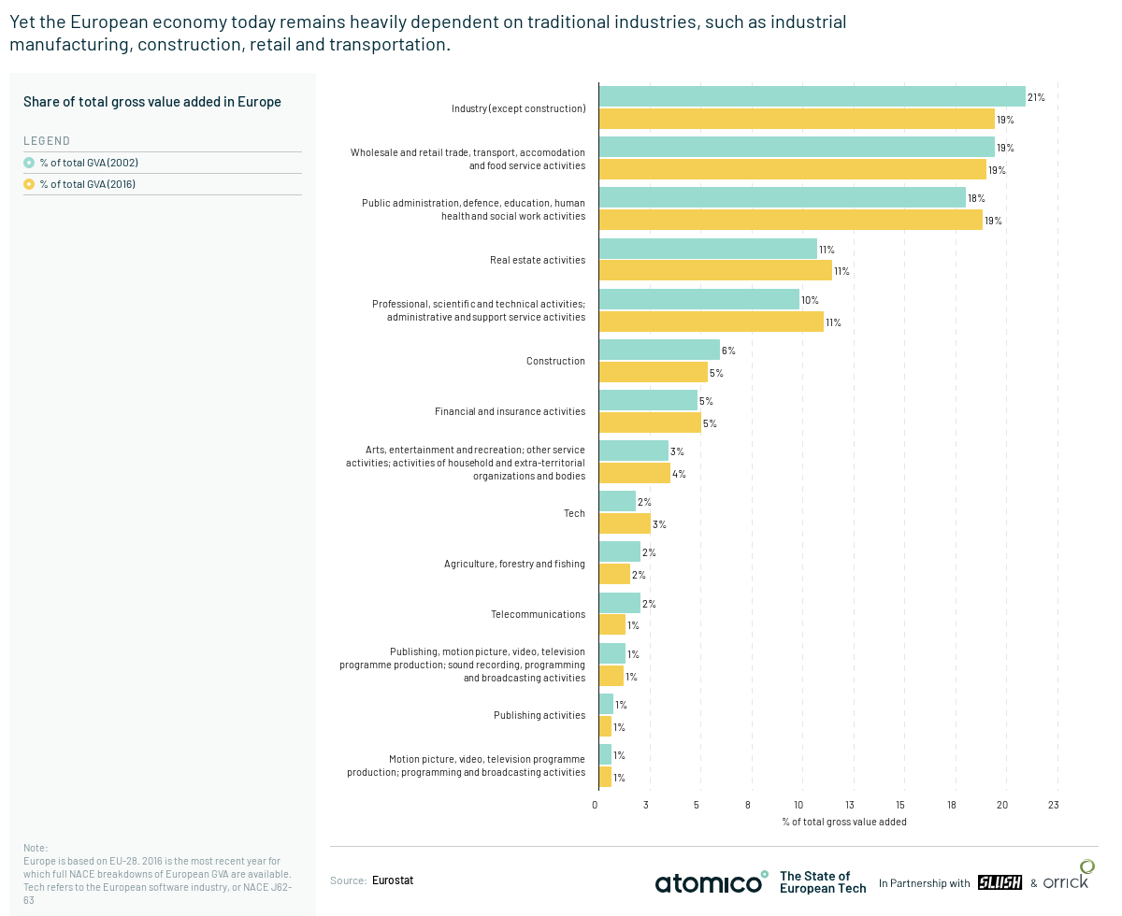

Slide 32
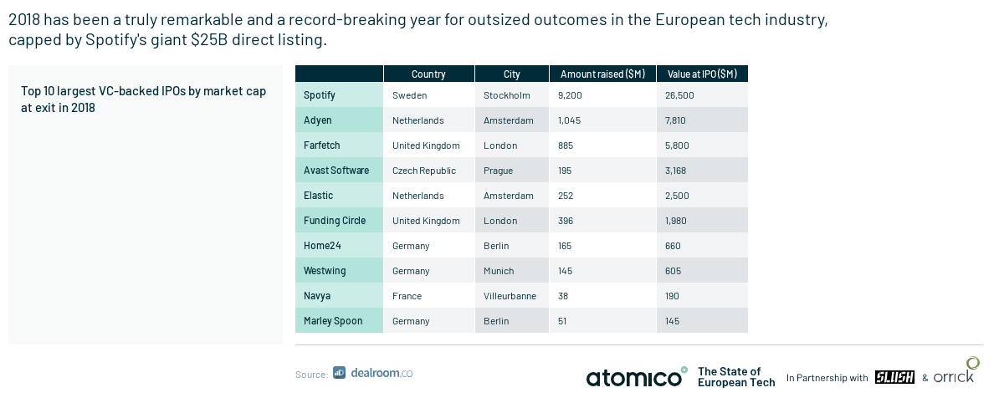
IPO’s in Europe

Slide 33

Netherware
www.netherware.nl
Notes:
33

Slide 34
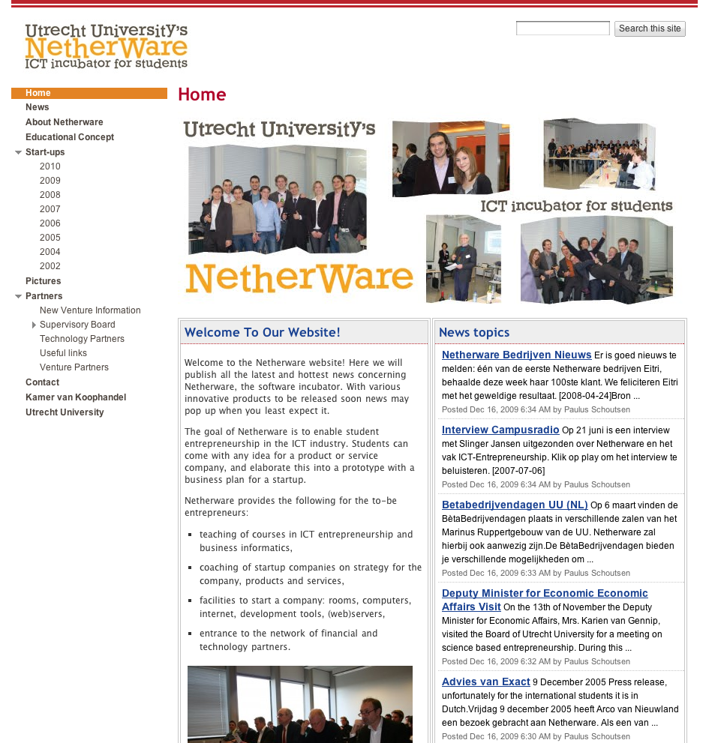
Netherware website
www.netherware.nl

Slide 35
Incubator role
Netherware is an ICT incubator for students that provides facilities and knowledge infrastructure to develop an ICT product or service and to continue as an independent start-up company.
Contacts: Sjaak Brinkkemper and Slinger Jansen

Slide 36
Netherware
Examples
Hours accounting and invoicing for law firms
Marketing tooling in messaging
Warehousing for the retail industry
On-line budget overview with community
Student monitoring for schools
Website to send SMS messages to groups
Dancing lessons in a browser
Camera placement for movie directors
40+ start-ups with 60 students (2 – 4 students each)
Permanent software incubator with coaching and network access
Run by students
Start-up offices in department
UtrechtInc in the Kruyt building at the campus

Slide 37
ICT Entrepreneurship
The students develop their own product or service ideas in a self composed team
End review for external Supervisory Board
Course with role models
After the course, the students decide for continuation:
office in incubator
coaching and network
company registration

Slide 38
Product teams
Each product team:
Works on its own product idea and functions as an independent product line
Proposes a project plan within the ECTS boundary for the 10 weeks block
Reports on the project plan; adapts planning
Can elaborate on anything viable for a ICT product or service, related to the stage of the idea
Innovation is essential for selection and grading!

Slide 39
Course milestones
Deliverables as assignments: Product Definition, Prototype, Validation Report, Minimum Viable Product, Business Plan, Spin-out Plan
You will also deliver many pitches, three of which are graded.
End review session with Board of Supervisors: end of June
The schedule is in Blackboard

Slide 40
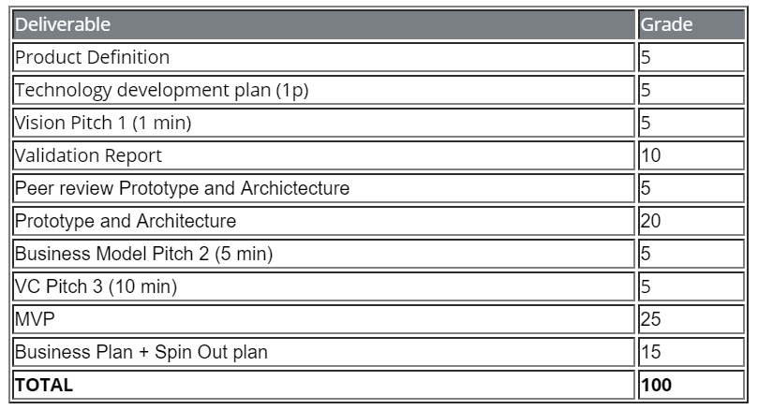
Deliverables
Add Horizontal performance

Slide 41
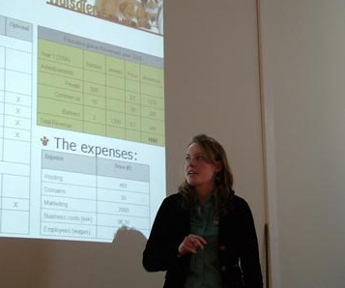
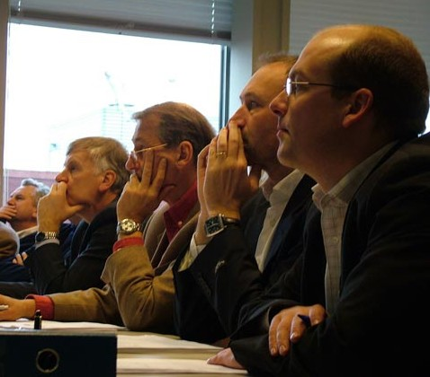
End review
All students present their products and business plans to Board of Supervisors
5 M€ Virtual Venture Capital
Members of Board of Supervisors
Venture capital fund
IT entrepreneur
Institutional investment
IT journalist
Marketing specialist
Notes:
What do we mean “5M Virtual Venture Capital”?

Slide 42
Example of previous Supervisory Board members
Merien ten Houten (founded nu.nl)
Kevin Voges, Yunoo
Rene van Erk, ISVWorld.com
Floris Vlasveld, Inspire
Robbert Hoefnagel, Fenceworks
Marvin van Dongen, Horeko
All have extensive experience in ICT start-ups

Slide 43

Where are you going to get revenue from?
And why do you say these people/companies are going to pay for your product..?

Slide 44
Weekly
20 hours of work; 12 in course
Lectures to present and discuss scientific work on software production
Guest lectures: to be announced
Students work on own product
Weekly report on Black board, group space

Slide 45
Study points
7.5 ECTS = 200 h
10 * 6 contact hours = 60
Remaining for own work = 140
Active as if working for a company!
Arrangements with team

Slide 46
Formation of teams
Formation of Netherware teams:
Product teams: today and on Friday
Provide your idea
Ideation exercise
Who is without idea?
Horizontal roles: Not in 20/21
Common Questions
IP? It’s yours.
An army of one? Nope

Slide 47
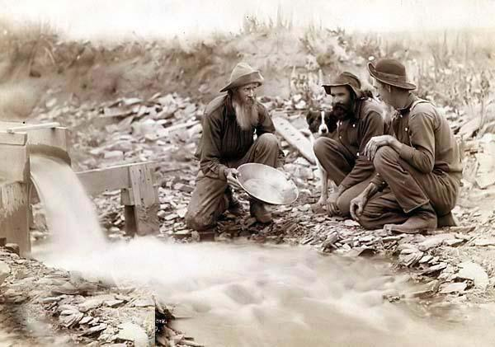
The way to get good ideas is to get lots of ideas,
and throw the bad ones away
Dr. Linus Pauling
Nobel-awarded biochemist

Slide 48

Do
or do not...
no try
there is
Master Yoda

Slide 49
In this course you make the difference!

Slide 50
Literature
Xu, L., & Brinkkemper, S. (2007). Concepts of product software. European Journal of Information Systems, 16(5), 531-541.
Cann, R. van, Brinkkemper, S., Jansen, S. Start-up Memories: Key Decisions in Success Stories. Palgrave-Macmillan, 272 pages.
Jansen, S., Cusumano, M., Brinkkemper, S. Software Ecosystems: Analyzing and Managing Business Networks in the Software Industry. In press, Edward Elgar Publishers, 350 pages.
Brinkkemper, S., Jansen, S. (2012) Collaboration in Outsourcing: A Journey to Quality, Palgrave-Macmillan, 361 pages
Jansen, S., Zande, T. van de, Brinkkemper, S., Stam, E. & Varma, V. (2015). How Education, Stimulation, and Incubation Encourage Student Entrepreneurship: Observations from MIT, IIIT, and Utrecht University. International Journal of Management Education 13(2), 170-181.

